Slide 1
MVC Architecture in Java web

Slide 2
Objectives
Understand MVC Architecture
  Model
  View
  Controller
MVC1 and MVC2
Apply MVC Architecture pattern in Java Web Application
MVC framework
<number>/18

Slide 3
What is MVC
MVC - Model View Controller is an architectural pattern that separates an application into three main logical components: the model, the view, and the controller.
  Model - represents an object carrying data, does all the work behind the scenes dealing with data, database, performing business logic.
  View - View represents the visualization of the data that model contains, presents information and interact with users
  Controller - Controller acts on both model and view. It controls the data flow into model object and updates the view whenever data changes. It keeps view and model separate.
Original: Thing-Model-View-Editor by a Norwegian computer scientist Trygve Reenskaug in 1979
<number>/41

Slide 4
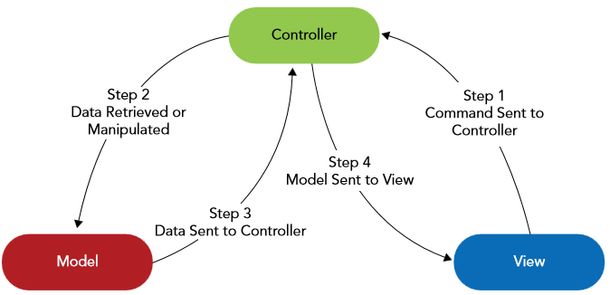
What is MVC
<number>/41

Slide 5
MVC advantages
Multiple developers can work simultaneously on the model, controller and views.
MVC enables logical grouping of related actions on a controller together. The views for a specific model are also grouped together.
Models can have multiple views.
Promotes re-usability of the business function implementations.
Avoid complexity by dividing an application into the three units
<number>/41

Slide 6
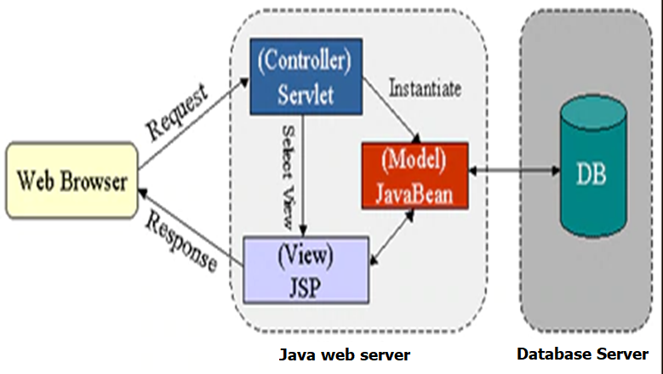
MVC for Java web application
<number>/41

Slide 7
The MVC pattern
Control flow
  The user performs an action on the interface
  The controller takes the input event
  The controller notifies to the model, which may not involve a change of state of the model
  Controller generates a new view. The view takes the data model
  The user interface waits for another user interaction, which starts a new cycle
<number>/41

Slide 8
The Model
The Model maintaining the state of the object - business domain of the application.
Model can be divided in to multi-tier
  Business logic layer
  Service layer
  Data access layer, persistent layer
Java Bean, POJO can be used for Model in MVC Java web application
  EJB for Enterpriser Application
<number>/41

Slide 9
The View
The View presents the model’s data, provides interaction interface to the user.
  The view knows how to access the model’s data, no need to know what this data means.
  Multiple views of the same information are possible for different views of application
Java web technology for the view
  JSP, JSTL
  Expression Language
  Custom Tags
<number>/41

Slide 10
The Controller
Controller is the link/interface between the view and the model
  Responsible for all the Request Processing by controlling the flow of control and by instantiating, invoking, and maintaining the business operations.
  Listens to events triggered by the view, invoke method on the model.
  May use notification mechanism to automatically trigger action
Java web technology for Controller
  Servlet
  Filter
  Event Listeners
<number>/41

Slide 11
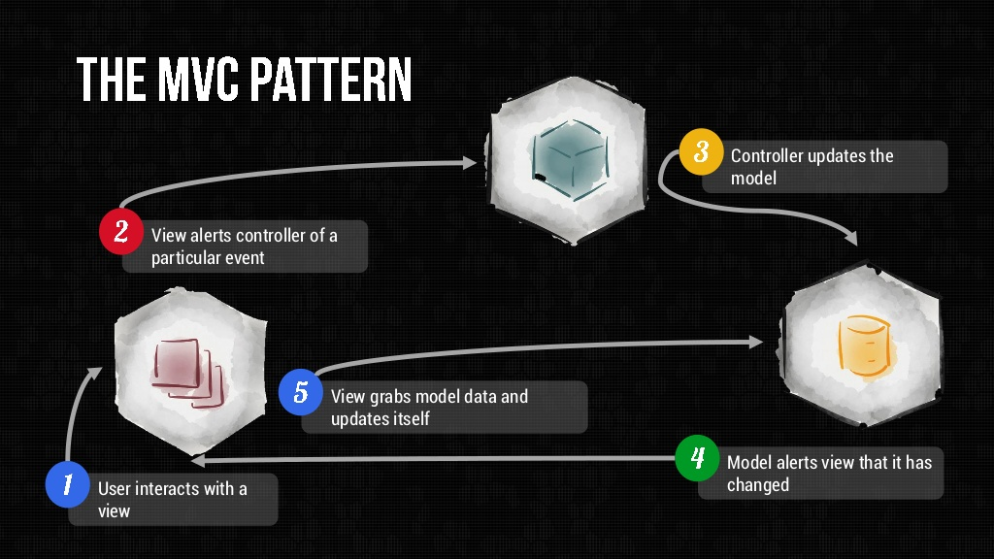
The MVC pattern
<number>/41

Slide 12
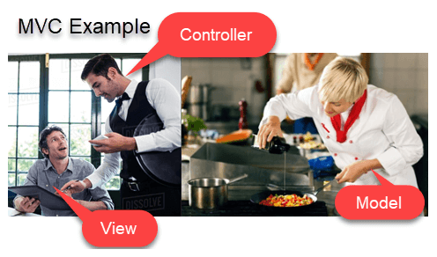
MVC in real world :D
View= Customer
Controller : Waiter
Model : Cooker
Database: Refrigerator
<number>/41

Slide 13
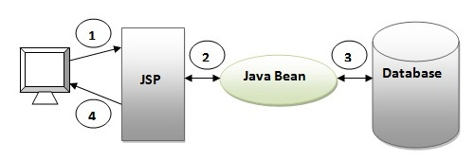
MVC1 and MVC2
MVC1 and MVC2 are 2 variations of the MVC architecture – no specification!
  MVC1 : page-centric, task-centric
    For simple, small applications
    May combine controller and view into JSP
    Can have multiple controller servlets
<number>/41

Slide 14
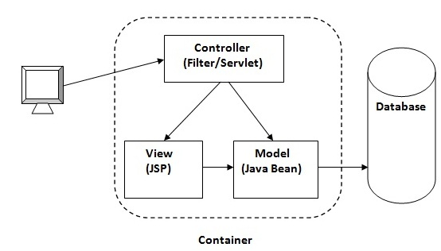
MVC1 and MVC2
MVC2: controller centric
  Navigation control is centralized by 1 Filter or 1 front Servlet
  Radical separation between between controller, model and view
  Easy to maintain, testing, scale-up
  Common code can be looked at only one place
  Suitable for large scale application
<number>/41

Slide 15
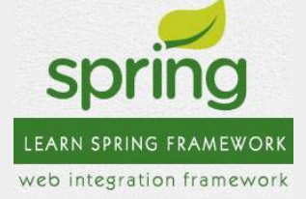
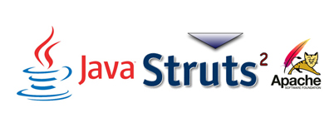
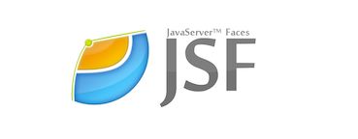
MVC Framework
Spring: one of the oldest Java Web Frameworks, but as one says: Old but Gold. Up to now, it is still utilized and constantly changing, developing more changes with Java.
Struts: a free and open source framework for creating simple Java apps. It is mainly used to create the foundation for web apps, and works on the pattern "MVC" - Model-View-Controller.
JavaServer Faces: supported by Oracle, so it produces a super long and complicated document.
<number>/41

Slide 16
Benefits
Organization
Rapid Application Development
Reusing Code
Parallel development
It represent the same information in different ways
The views and application behavior should reflect the manipulations of the data immediately
It allow different user interface standards or port it to other environments where the application code should not be affected
<number>/41

Slide 17
Summary
MVC Introduction
What is MVC?
MVC Architecture
The Model
The View
The Controller
MVC1 and MVS2
Benefits
MVC pattern
Where is can use?
MCV in Java
Framework
<number>/41

Slide 18
Constructivity questions
What is MVC Pull and Push model?
What should be considered when writing the code for Java bean class to suit MVC architecture?
What does the multi-tier application model mean when designing the model layer for an MVC application? Analyze the advantages and disadvantages of this model.
What is the common code that every application's tasks need? Where should you code them?
What should be considered when writing the code for JSP pages to suit MVC architecture?
<number>/41

